Slide 1
Credit Card Fraud Detection
Hanwei Guo

Slide 2
Table of Contents
Introduction
Data source and analysis
Data processing
Modeling and analysis
Summary and result

Slide 3
Introduction

Slide 4
Credit Card and Fraudulent Activities
Credit card fraud refers to payment to another account controlled by criminal.
This project focuses on using credit card activity data to identify credit card frauds.
Frauds may include authorized (such as scamming) and unauthorized (such as skimming or account take-over)
Unauthorized fraudulent activities could demonstrate very different trait when comparing to card owner’s usual consumption behavior
Authorized fraudulent activities usually would not demonstrate vastly different trait; they could be tracked from both ends (card owner end: owner likely to be deceived; criminal end: suspicious payment recipient).

Slide 5
Data source & analysis

Slide 6
Data source
The dataset is from Kaggle. Its records are simulated credit card transactions generated from Sparkov, dated from 01/01/2019 – 12/31/2020. This dataset contains over 185k simulated credit card transaction activities, covering 1000 card owners and 800 merchants.
Link: https://www.kaggle.com/kartik2112/fraud-detection
The columns could be broadly divided into these types

Slide 7
Data & Variables
Variable Type | Variable name
identifier | “cc_num”: credit card number; identifier for each card “trans_num”: transaction number; identified for each transaction record
Transaction details | “trans_date_trans_time”: date and time of transaction “amt”: amount of this transaction
Customer information | “first”, “last”: first name and last name of card holder “gender”, “job”, “dob”: gender, job and date of birth of card holder “street”, “city”, “state”, “zip”, “lat”, “long”: living address of card holder
Merchant information | “merchant”, “category”: name and category of merchant “merch_lat”, “merch_long: address of merchant
Fraud information | “is_fraud”: class to identify if this transaction is fraud or not

Slide 8
Data Processing

Slide 9
Using the dataset
Transaction profiling
Assumption: transaction patterns in one card is consistent, determined by the card owner. New transactions will likely follow old transaction patterns
To-do: build a profile for each card; a profile of transaction habits
Fraud: different transaction pattern could imply fraud; card could be operated by other people
High risk card holder
Assumption: authorized frauds; some card holders are vulnerable to authorized frauds
To-do: use card owner information
High risk merchant
Assumption: some merchants are high-risk
To-do: merchants that seldom show up; merchants highly associated with frauds

Slide 10
Modeling Choice
The dataset contains a target value (is_fraud). Two methods for fraud detection.
1. Supervised Machine Learning
Use existing and derived columns to establish a model predicting is_fraud.
Concern: this method only identifies known fraud types; vulnerable to new fraud types
2. Unsupervised Machine Learning
Ignore fraud class; use existing and derived columns to group transactions by similarities; identify fraud by those transactions which are not similar to norm

Slide 11
Data Processing

Slide 12
Dividing the dataset: real-world problem
In practice,
Historical data -> process, analyze, cross-validate -> new data -> add to historical data and improve analysis
When cross-validating, no future data is attainable
Divide the data by time
Total 2 years of data (01/01/2019 – 12/31/2020) [1.85m activities]
First 1.5 years for analysis and cross-validation [1.32m activities]
Last 0.5 year as future data (test for model applications) [0.53m activities]
Imbalanced dataset
In first 1.5 years: 7.6k fraud transactions (r. 0.57%); hard to over-sampling/under-sampling with bootstrapping
Choose a different metrics in supervised models: Precision-Recall Curve
Apply stratified k-fold cross-validation
Add class weight in classification models

Slide 13
Profiling based on transactions
Create derived variables for each card
Transaction amount:
Thresholds for each card: extreme, high, medium, low
Transaction address location
Compare card holder’s living address (latitude and longitude) and merchant location
Divide transaction into local, national and international
Transaction datetime
Weekday: Mon, Tue, ..., Sun
Time of a day: morning, afternoon, evening, midnight
Product type
No exact product type, approximated by merchant category
Create dummy variables for modeling

Slide 14
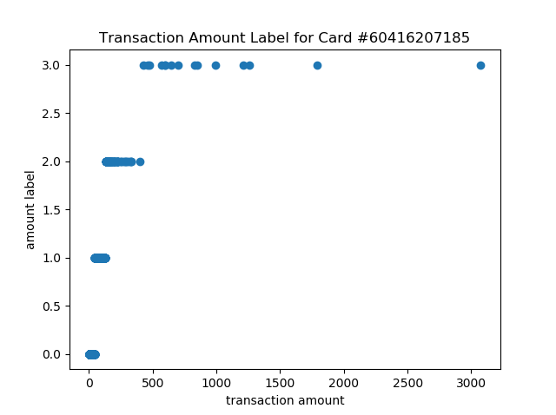
Labeling Transaction Amount
Perform operation for each card number, assign four labels
3 – extreme
Refers to extremely high transaction amount based on the card’s transaction history
Finding outliers using Z-score
Flag all points above μ+3σ (68-98-99 for normal distribution)
0, 1, 2 – low, medium, high
For the rest of the data, use k-means clustering on transaction amount, k=3
Figure to the left illustrates amount and its derived label for one card

Slide 15
Profiling based on transactions
Transaction pattern for each card is profiled: summarized into categorical variables
Goal: run individual models on each card
Profiling by customer vs profiling by card
One customer may treat cards differently: for example, one would buy more accommodation products with travel cards (more cashback on travel) and more commodity with shopping cards

Slide 16
Risk-to-Fraud
Association between customer demographics and frauds
Association between merchants and frauds

Slide 17
Modeling and Analysis

Slide 18
Modeling
Card profiling
Model 1: Random forest (set of models)
Dataset: subset of
Dependent: fraud class (1, 0); Independent: amount label, address label, weekday label, time label, category dummies
Customer and merchant risk-to-fraud
Model 2: High risk customers
Dependent: probability of fraud cases; Independent: customer demographics
Model 3: High risk merchants
Dependent: probability of fraud cases; Independent: merchant information
Finalize modeling
For each transaction:
Use model 1 to calculate the probability of fraud from card profile (transaction pattern)
Use model 2 to obtain the probability of high-risk customers (from coefficients)
Use model 3 to obtain the probability of high-risk merchants
Run final model:
Dependent: fraud class (1,0); independent: profile fraud prob, customer risk prob, merchant risk prob

